Slide 1
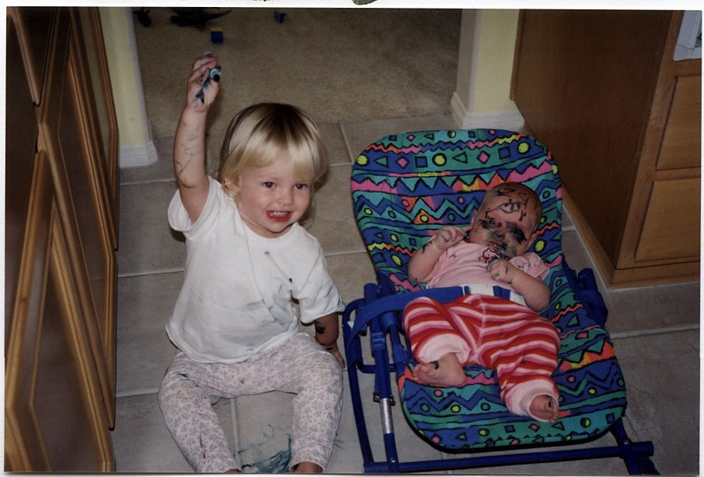
WARNING: Don’t get carried away with your classification markings…
Remember that you must receive formal training and complete refresher training
every 2 years thereafter on the proper application of derivative classification markings

